Slide 1

Unit 4: Randomized Data Structures Data Structures-II
Dr. Dattatray G. Takale
Dattatray.takale@viit.ac.in
Department of Data Science
BRACT’S, Vishwakarma Institute of Information Technology, Pune-48
(An Autonomous Institute affiliated to Savitribai Phule Pune University)
(NBA and NAAC accredited, ISO 9001:2015 certified)

Slide 2
Unit -4 :Contents
Randomized Data Structures
Preliminaries of randomized algorithm and probability theory, Skip Lists: Structural Properties of Skip Lists, Space Complexity of skip list. Treap: A Randomized Binary Search Tree
Dr. Dattatray G Takale, Department of Computer Engineering, VIT, Pune-37

Slide 3

Randomized Algorithm
A randomized algorithm is an algorithm that uses random numbers at one or more steps during its execution to make decisions.
For the same input, it may produce different outputs or execution paths
Its performance is analyzed using probability (expected time, success probability)
Key Characteristics
Uses a random number generator
Behavior depends on random choices
Performance measured in:
Expected time complexity
Probability of correctness (if applicable)
Examples of Randomized Algorithms
Example 1: Randomized Quicksort
Instead of Selecting the first or last element as pivot:
Choose a random pivot
Partition the array based on pivot
Why randomization helps:
Gives expected time complexity:
$$O\left(n\log{n}\right)$$
Dattatray G Takale, Department of Computer engineering, VIT, Pune- 411037

Slide 4
Randomized Algorithm
Advantages of Randomized Algorithms
Simpler than deterministic alternatives
Avoid worst-case scenarios
Efficient in practice
Often faster on average
Disadvantages
Results may vary between runs
Some algorithms may produce incorrect output (Monte Carlo)
Harder to debug due to randomness
Dattatray G Takale, Department of Computer engineering, VIT, Pune- 411037

Slide 5

Motivation Randomized Algorithm
Randomization is introduced in algorithms to overcome limitations of deterministic approaches and to achieve better efficiency, simplicity, and robustness.
1. Avoiding Worst-Case Scenarios
Deterministic algorithms can perform poorly on specific inputs.
In QuickSort, if the pivot is always the smallest/largest element:
$$O\left(n^{2}\right)$$
✔ Solution: Randomly choose pivot → Expected performance becomes:
$$O\left(n\log{n}\right)$$
2. Simplicity of Design
Randomized algorithms are often simpler than deterministic ones.
👉 Example:
Balanced trees (AVL, Red-Black) require complex rotations
Randomized structures like Skip Lists and Treaps:
No strict balancing rules
Easier implementation
Dattatray G Takale, Department of Computer engineering, VIT, Pune- 411037

Slide 6

Motivation Randomized Algorithm
Good Expected Performance
Even though randomness is involved, these algorithms guarantee highly efficient expected performance.
Skip List operations: $O\left(\log{n}\right)$
Treap operations: $O\left(\log{n}\right)$
✔ Performance is consistent on average
Efficient Approximation and Probabilistic Solutions
Some problems are too complex to solve exactly.
✔ Randomized algorithms provide:
Fast approximate solutions
Acceptable accuracy
👉 Example:
Primality testing (Monte Carlo methods)
Sampling-based algorithms
Dattatray G Takale, Department of Computer engineering, VIT, Pune- 411037

Slide 7
Deterministic Algorithms
Vs Randomized Algorithm
Aspect | Deterministic Algorithms | Randomized Algorithms
Definition | Fixed sequence of steps | Uses randomness in decisions
Output | Same for same input | May vary for same input
Behavior | Predictable | Probabilistic
Execution Path | Fixed | Varies
Time Complexity | Fixed | Expected time complexity
Worst-case | May degrade | Avoided using randomness
Design | Complex sometimes | Simpler
Performance | Input dependent | Consistent on average
Correctness | Always correct | May be probabilistic
Examples | Merge Sort, BST | QuickSort, Skip List
Dattatray G Takale, Department of Computer engineering, VIT, Pune- 411037

Slide 8
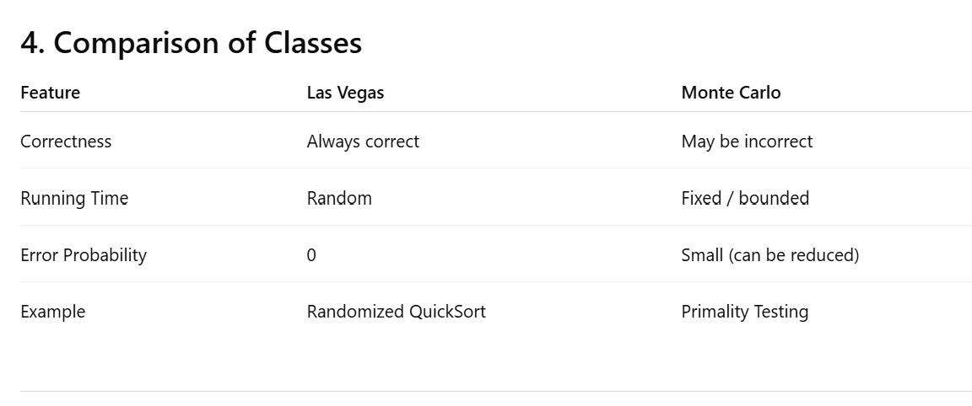
Classification of Randomized Algorithms
Two main categories:
1. Las Vegas Algorithms
2. Monte Carlo Algorithms
Both rely on randomization but differ in correctness guarantees.
Las Vegas Algorithms: Las Vegas algorithm always produces the correct result, but its running time is random.
Characteristics:
Always produce correct results
Running time depends on random choices
Performance analyzed using expected time complexity
Example:
Randomized Quicksort
Expected running time O(n log n).
Monte Carlo Algorithms: A Monte Carlo algorithm has a fixed running time, but the result may be incorrect with a small probability.
Characteristics:
Fixed running time
Small probability of producing incorrect results
Error probability can be reduced by repetition
Example:
Randomized primality testing.
Dattatray G Takale, Department of Computer engineering, VIT, Pune- 411037

Slide 9
Applications of Randomized
Algorithms
Sorting algorithms
Hash tables and data indexing
Graph algorithms
Cryptography
Machine learning
Distributed systems
Dattatray G Takale, Department of Computer engineering, VIT, Pune- 411037

Slide 10
Probability Theory in
Algorithms
Probability theory provides tools to analyze randomized algorithms.
Key concepts:
• Random experiments
• Sample space
• Events
• Random variables
• Expected value
• Variance
Dattatray G Takale, Department of Computer engineering, VIT, Pune- 411037

Slide 11
Random Experiments
A random experiment is a process whose outcome cannot be predicted with certainty."
Examples:
• Coin toss
• Dice roll
• Random number generation
Dattatray G Takale, Department of Computer engineering, VIT, Pune- 411037

Slide 12
Sample Space
The set of all possible outcomes of a random experiment.
Example:
Coin toss: {Head, Tail}
Dice roll: {1,2,3,4,5,6}
Dattatray G Takale, Department of Computer engineering, VIT, Pune- 411037

Slide 13
Events
“An event is a subset of the sample space."
Example:
Dice roll event 'even number' = {2,4,6}
Dattatray G Takale, Department of Computer engineering, VIT, Pune- 411037

Slide 14
Probability Definition
Probability is a measure of the likelihood that an event will occur in a random experiment.
Probability of event A:
P(A) = Favorable outcomes / Total outcomes
Probability of getting even number on dice:
P(A)=3/6=1/2
Key Points
Based on random experiments
Used to quantify uncertainty
Fundamental in randomized algorithms and data structures
Dattatray G Takale, Department of Computer engineering, VIT, Pune- 411037

Slide 15
Random Variable
“A random variable assigns numerical values to outcomes."
Types:
• Discrete random variables
• Continuous random variables
Example:
Coin toss
X = 1 if Head
X = 0 if Tail
Dattatray G Takale, Department of Computer engineering, VIT, Pune- 411037

Slide 16
Advantages of Randomized algorithms
Simpler implementations
Good expected performance
Robust against worst‑case inputs
Useful in large-scale data systems
Dattatray G Takale, Department of Computer engineering, VIT, Pune- 411037

Slide 17
Treap of Randomized
Algorithms
Treap introduced by: Raimund Seidel and Cecilia Aragon (1989)
Treap = Tree + Heap
A randomized balanced binary search tree where:
• Keys maintain BST ordering
• Priorities maintain heap ordering
Structure is determined by both key and priority.
Goal: randomized alternative to deterministic balanced trees
Provides expected logarithmic performance.
Treap maintains two properties simultaneously:
1. Binary Search Tree property on keys
2. Heap property on priorities
Random priorities probabilistically balance the tree.
Dattatray G Takale, Department of Computer engineering, VIT, Pune- 411037

Slide 18
Structure of Treap
Typical node fields:
• key
• priority
• left pointer
• right pointer
Optional:
• subtree size
• parent pointer
• lazy propagation flags
Node
{
int Key;
int Priority;
Node L_Pointer;
Node R_Pointer;
}
Dattatray G Takale, Department of Computer engineering, VIT, Pune- 411037

Slide 19
Treap of Randomized
Algorithms
BST
For every node x:
All keys in left subtree < key(x)
All keys in right subtree > key(x)
Ensures efficient search operations.
Heap
Treaps usually use Max-Heap priority:
priority(parent) ≥ priority(child)
Alternatively, Min-Heap can be used.
Heap property determines the structural balance.
Dattatray G Takale, Department of Computer engineering, VIT, Pune- 411037

Slide 20
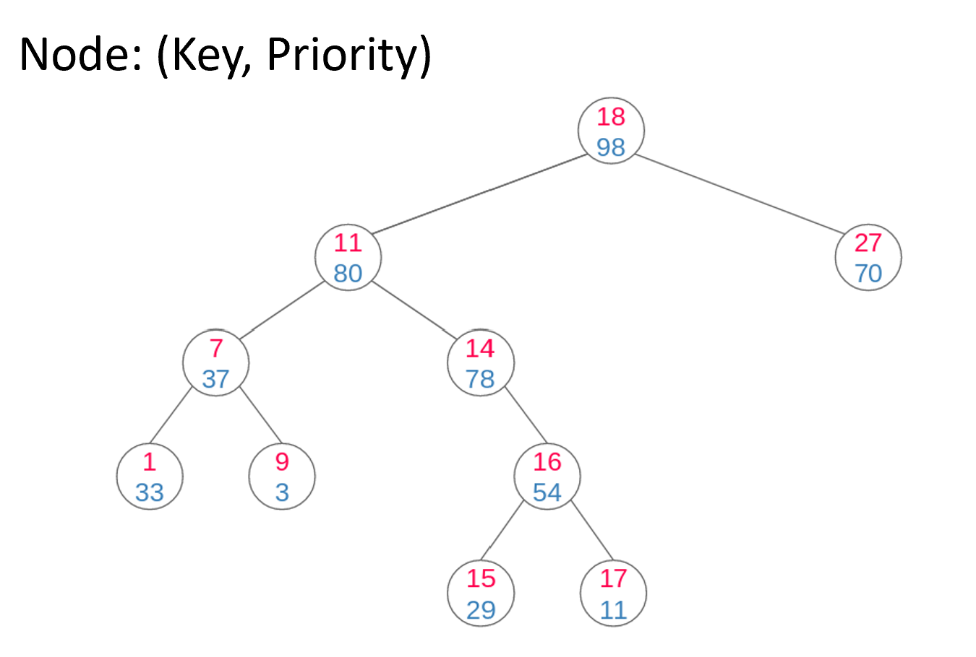
Treap of Randomized
Algorithms
Dattatray G Takale, Department of Computer engineering, VIT, Pune- 411037

Slide 21
Construction of Treap
Treap structure is equivalent to:
Building a BST ordered by keys
Then adjusting nodes to satisfy heap property by doing suitable rotations.
Treaps use standard BST rotations:
• Left rotation
• Right rotation
Rotations restore heap property without breaking BST order.
Dattatray G Takale, Department of Computer engineering, VIT, Pune- 411037

Slide 22
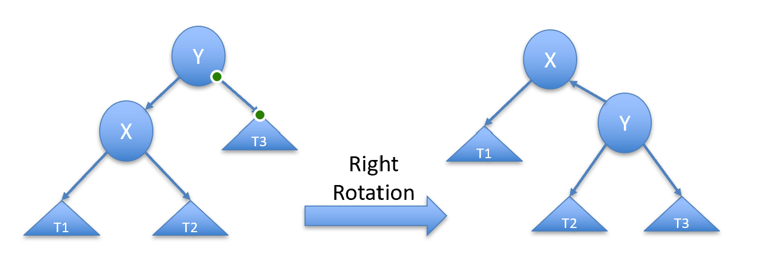
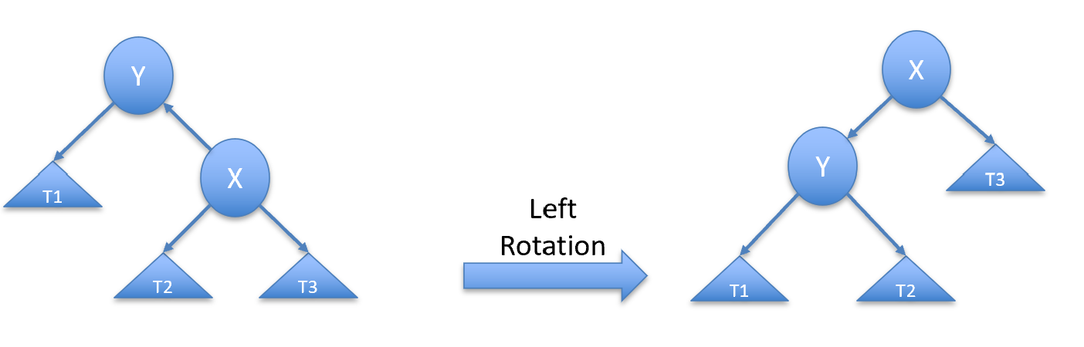
Construction of Treap
Right Rotation
Used when left child has higher priority than parent.
Left child becomes new parent.
Original parent becomes right child.
Left Rotation
Used when right child has higher priority than parent.
Right child becomes new parent.
Original parent becomes left child.
Dattatray G Takale, Department of Computer engineering, VIT, Pune- 411037

Slide 23
Insertion Algorithm
1. Insert node as in standard BST
2. Assign random priority
3. Rotate node upward until heap property satisfied.
Dattatray G Takale, Department of Computer engineering, VIT, Pune- 411037

Slide 24
Insertion Pseudocode
Insert(key):
node ← BST_insert(key)
node.priority ← random()
while parent.priority < node.priority:
rotate(node)
Dattatray G Takale, Department of Computer engineering, VIT, Pune- 411037

Slide 25
Deletion Algorithm
1. Locate node to delete
2. Rotate node downward until leaf
3. Remove leaf node
Maintains both BST and heap properties.
Dattatray G Takale, Department of Computer engineering, VIT, Pune- 411037

Slide 26
Deletion Pseudocode
Delete(node):
while node not leaf:
rotate child with larger priority upward
remove node
Dattatray G Takale, Department of Computer engineering, VIT, Pune- 411037

Slide 27
Search Operation
Search identical to BST search:
Compare key
Move left or right
Expected complexity O(log n).
Dattatray G Takale, Department of Computer engineering, VIT, Pune- 411037

Slide 28
Time Complexity
Expected:
Search: O(log n)
Insert: O(log n)
Delete: O(log n)
Dattatray G Takale, Department of Computer engineering, VIT, Pune- 411037

Slide 29
Treap vs AVL Tree
AVL Tree:
Strict height balancing
Complex rotations
Treap:
Random balancing
Simpler implementation
Dattatray G Takale, Department of Computer engineering, VIT, Pune- 411037

Slide 30
Treap vs Red-Black Tree
Red-Black Tree:
Color rules and multiple balancing cases
Treap:
Random priorities
Fewer balancing rules
Dattatray G Takale, Department of Computer engineering, VIT, Pune- 411037

Slide 31
Applications
Dynamic ordered sets
Range queries
Competitive programming
Text editors (rope structures)
Database indexing experiments
Dattatray G Takale, Department of Computer engineering, VIT, Pune- 411037

Slide 32
Advantages
Simple implementation
Supports split/merge naturally
Expected logarithmic operations
Dattatray G Takale, Department of Computer engineering, VIT, Pune- 411037

Slide 33
Skip List
Dattatray G Takale, Department of Computer engineering, VIT, Pune- 411037

Slide 34
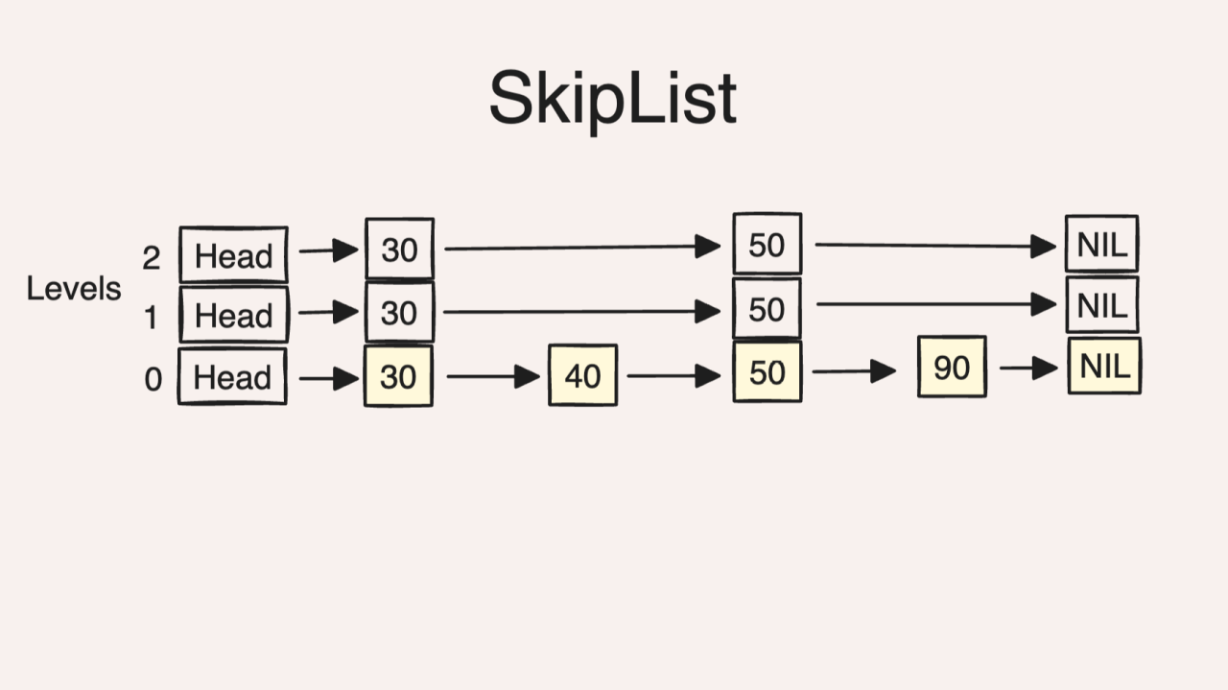
Introduction to Skip Lists
Skip List is a probabilistic data structure used for fast search, insertion, and deletion.
A Skip List is a layered linked list that allows fast searching by “skipping” elements.
It maintains elements in sorted order and uses multiple levels of linked lists.
Average time complexity for operations is O(log n).
Instead of one list, we use multiple levels:
Level 0 → Normal linked list
Level 1 → Skip some elements
Level 2 → Skip more elements
Dattatray G Takale, Department of Computer engineering, VIT, Pune- 411037

Slide 35
History
Skip Lists were introduced by William Pugh in 1989.
They were designed as an alternative to balanced binary search trees.
They use randomization instead of complex balancing operations.
Dattatray G Takale, Department of Computer engineering, VIT, Pune- 411037

Slide 36
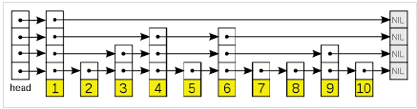
Basic Idea
A skip list contains multiple levels of linked lists.
The bottom level (Level 0) contains all elements in sorted order.
Higher levels contain fewer elements that act as shortcuts.
These shortcuts allow skipping large portions of the list during searching.
Dattatray G Takale, Department of Computer engineering, VIT, Pune- 411037

Slide 37
Structure of Skip List
Each node contains:
Node
{
Key (value)
forward[0..level] Pointer(Array)
}
The number of pointers depends on the level of the node.
Forward[i] points to the next node at level i.
Dattatray G Takale, Department of Computer engineering, VIT, Pune- 411037

Slide 38
Header Node
A special header node is used.
It contains the maximum level pointers.
It acts as the starting point of the skip list.
Max_Lev=4
Node Head[Max_Lev];
Header → Level3 → Level2 → Level1 → Level0
Dattatray G Takale, Department of Computer engineering, VIT, Pune- 411037

Slide 39
Random Level Generation
When inserting a node, its level is determined randomly.
Typically implemented using coin flips.
This ensures probabilistic balancing.
General formula:
P(level=i)=(1/2)^{i+1}
Code:
level = 0 while (random() < 0.5) level++
Dattatray G Takale, Department of Computer engineering, VIT, Pune- 411037

Slide 40
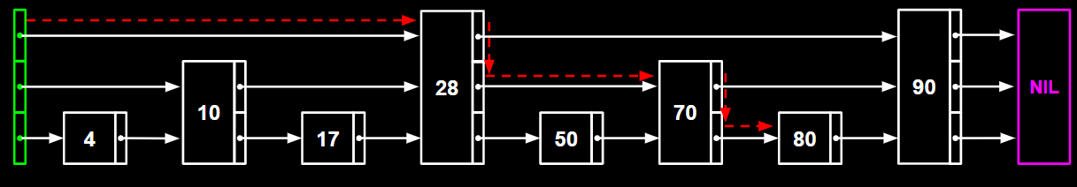
Search Operation
Search starts from the highest level.
Move forward while next key is smaller.
If next key is larger, move down one level.
Continue until level 0.
Search(80)
Dattatray G Takale, Department of Computer engineering, VIT, Pune- 411037

Slide 41
Insertion Operation
Steps:
1. Search correct position.
2. Generate random level.
3. Update forward pointers at each level.
Dattatray G Takale, Department of Computer engineering, VIT, Pune- 411037

Slide 42
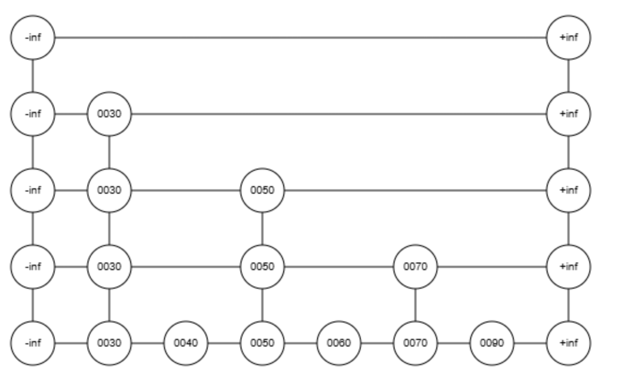
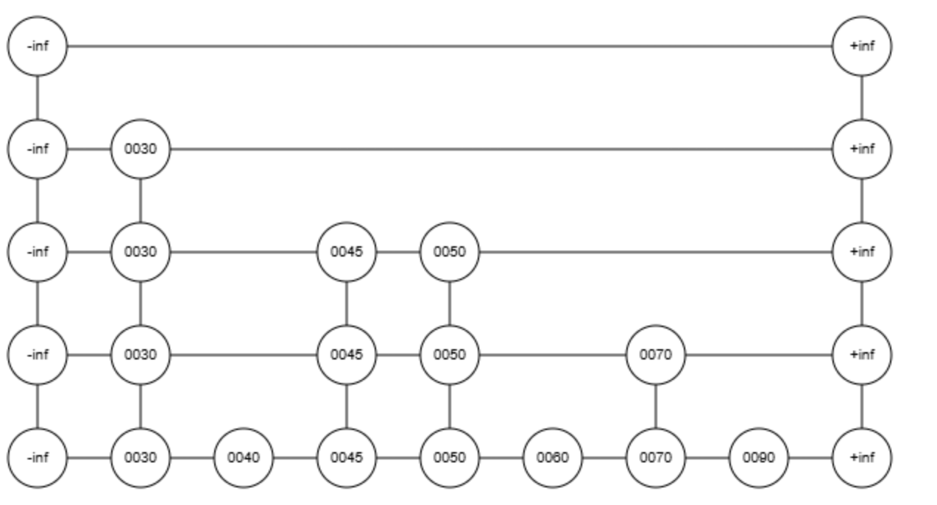
Insertion Operation
Insert ( 45)
Dattatray G Takale, Department of Computer engineering, VIT, Pune- 411037

Slide 43
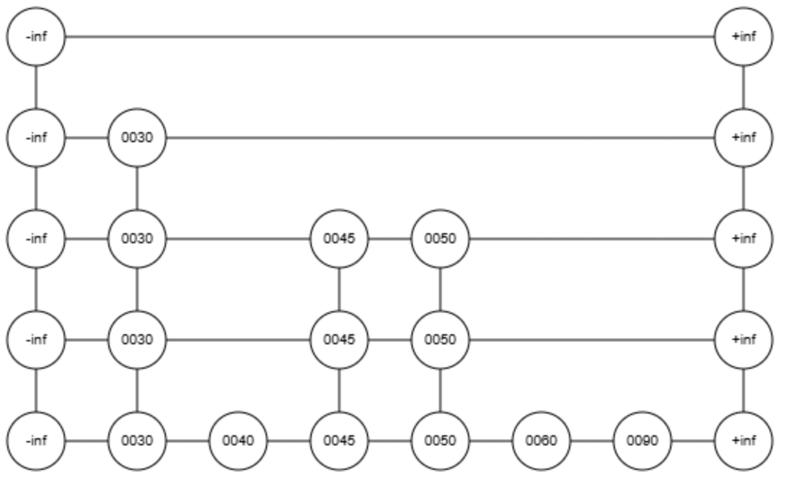
Deletion Operation
Steps:
1. Locate node using search.
2. Update forward pointers.
3. Remove node from all levels.
Delete (70)
Dattatray G Takale, Department of Computer engineering, VIT, Pune- 411037

Slide 44
Time Complexity
Average case:
Search: O(log n)
Insert: O(log n)
Delete: O(log n)
Worst case: O(n)
Dattatray G Takale, Department of Computer engineering, VIT, Pune- 411037

Slide 45
Advantages
• Simple implementation
• No tree rotations
• Efficient expected performance
• Good for concurrent systems
Dattatray G Takale, Department of Computer engineering, VIT, Pune- 411037

Slide 46

























Applications
Skip lists are used in:
• Databases
• Memory indexing
• Distributed systems
• Concurrent data structures
Dattatray G Takale, Department of Computer engineering, VIT, Pune- 411037

